Slide 1
Introduction to Microscopy and imaging systems

Slide 2
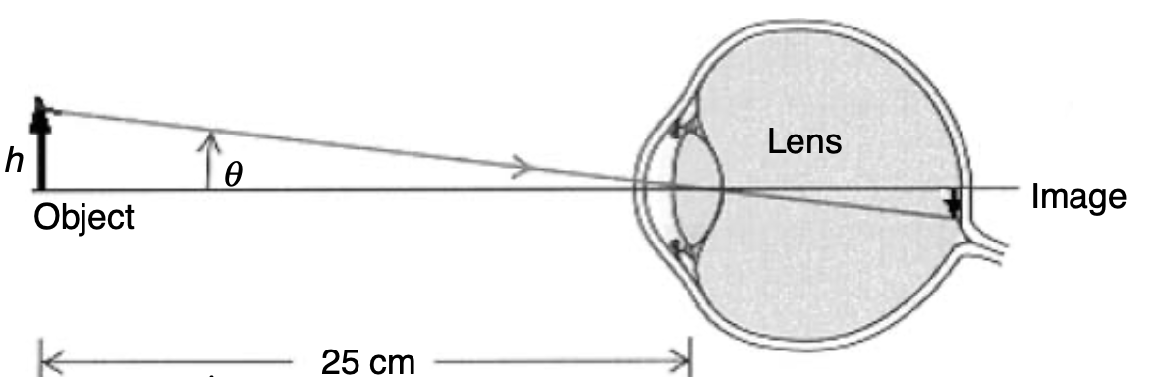
Why do we need microscopes?
Magnify objects so we can see them with our “eyes”.
Our eye is an “imaging system” that projects an object on our retina using one lens.
The strength of this lens is adjustable between totally relaxed (projects infinity onto the retina) to maximum curvature (projects objects that are at the near point of the eye on the retina). The near point is the minimum distance an object can be away from the eye to still be focussed on the retina.
The closer an object is to the eye, the larger its viewing angle 𝜃, the larger its projection on the retina will be.

Slide 3
If we go closer than the near point, the object can not be focussed on the retina anymore →there is a maximum resolving power of our eyes
To increase the resolving power of our eyes, we can use lenses to increase the object on the retina. The simplest is the magnifier glass.

Slide 4
Short geometrical optics refresher:
Convex lenses (lenses with positive curvature) bend light towards the optical axis.
If an object is at the focal distance of the lens, the image is projected into infinity.
If an object is further away than the focal distance, the lens will create a real image on the other side of the lens, opposite where the object is. The image is inverted.
If an object is closer to the lens than the focal distance, the lens will create a virtual image on the same side of the lens where the object is

Slide 5
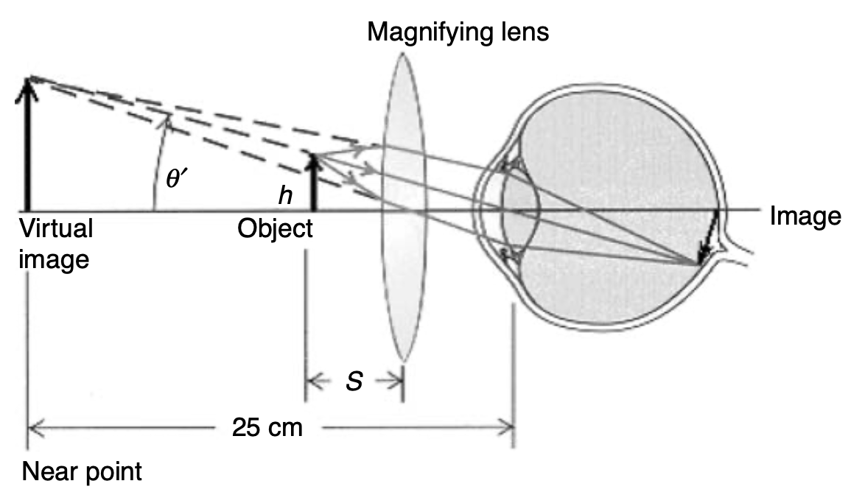

With a magnifying glass, we create a virtual image farther away from the eye, so that when it is focussed on the retina by the eye lens, it is larger than the original object.
The ratio of the viewing angle with the magnifying lens over the viewing angle without the magnifying lens is the angular magnification
$$M_{a}=\frac{θ′}{θ}$$

Slide 6
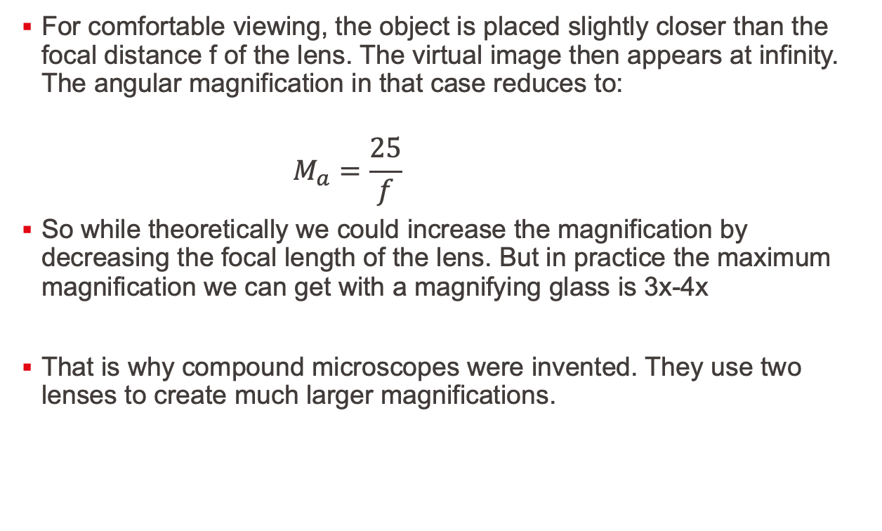
For comfortable viewing, the object is placed slightly closer than the focal distance f of the lens. The virtual image then appears at infinity. The angular magnification in that case reduces to:
$$M_{a}=\frac{25}{f}$$
So while theoretically we could increase the magnification by decreasing the focal length of the lens. But in practice the maximum magnification we can get with a magnifying glass is 3x-4x
That is why compound microscopes were invented. They use two lenses to create much larger magnifications.

Slide 7
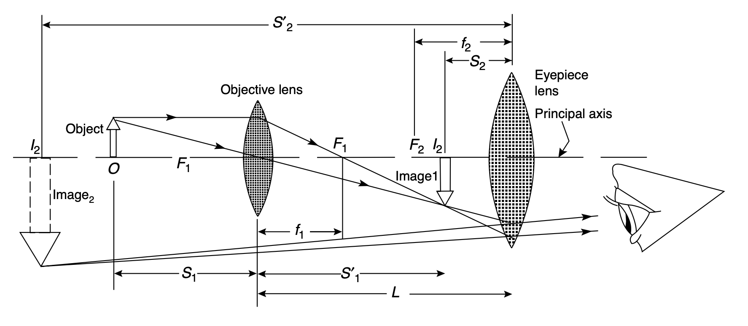
The compound microscope

Slide 8
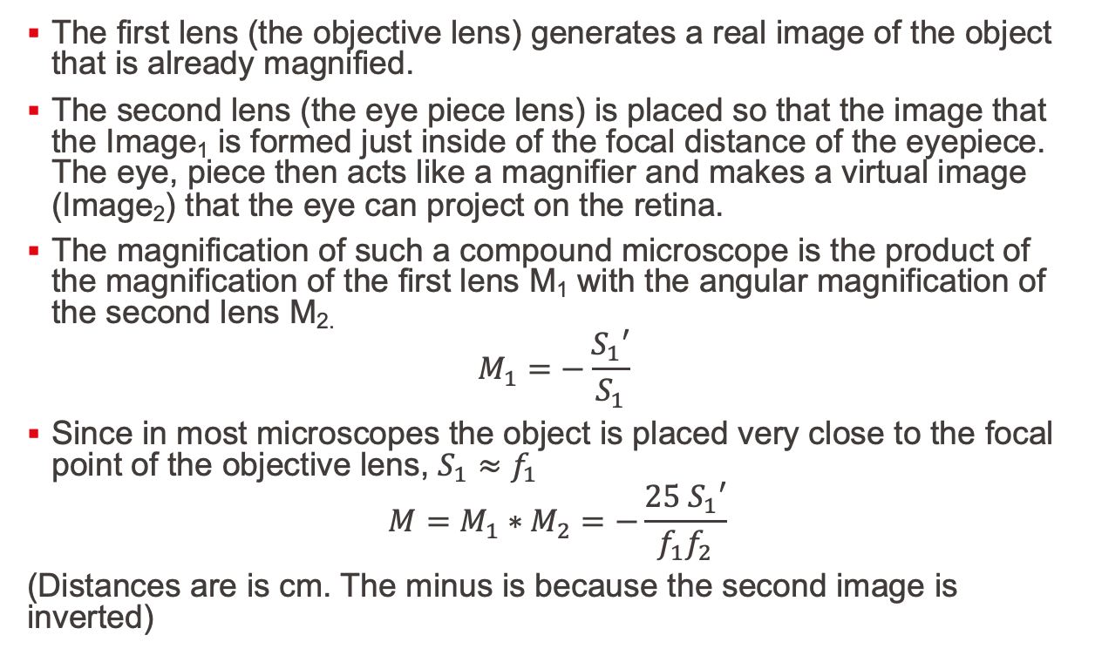
The first lens (the objective lens) generates a real image of the object that is already magnified.
The second lens (the eye piece lens) is placed so that the image that the Image₁ is formed just inside of the focal distance of the eyepiece. The eye, piece then acts like a magnifier and makes a virtual image (Image₂) that the eye can project on the retina.
The magnification of such a compound microscope is the product of the magnification of the first lens M₁ with the angular magnification of the second lens M_{2.}
$$M_{1}=−\frac{S_{1}′}{S_{1}}$$
Since in most microscopes the object is placed very close to the focal point of the objective lens, $S_{1}≈f_{1}$
$$M=M_{1}∗M_{2}=−\frac{25 S_{1}′}{f_{1}f_{2}}$$
(Distances are is cm. The minus is because the second image is inverted)

Slide 9
Using compound microscopes it is possible to generate microscopes with up to 200x magnification.
One problem with this kind of compound microscope is that they have a specified distance from the nosepiece opening, where the objective barrel is secured, to the ocular seat in the eyepiece tubes. This distance is the tube length. Any deviation from this length causes a change in the behaviour of the microscope. This is particularly a problem if additional optical components have to be placed in the beam path for advanced microscopy techniques such as fluorescence microscopy, phase contrast, or DIC.
To overcome this, infinity corrected microscopes have been invented in 1930 and have become standard since the 1980’s

Slide 10
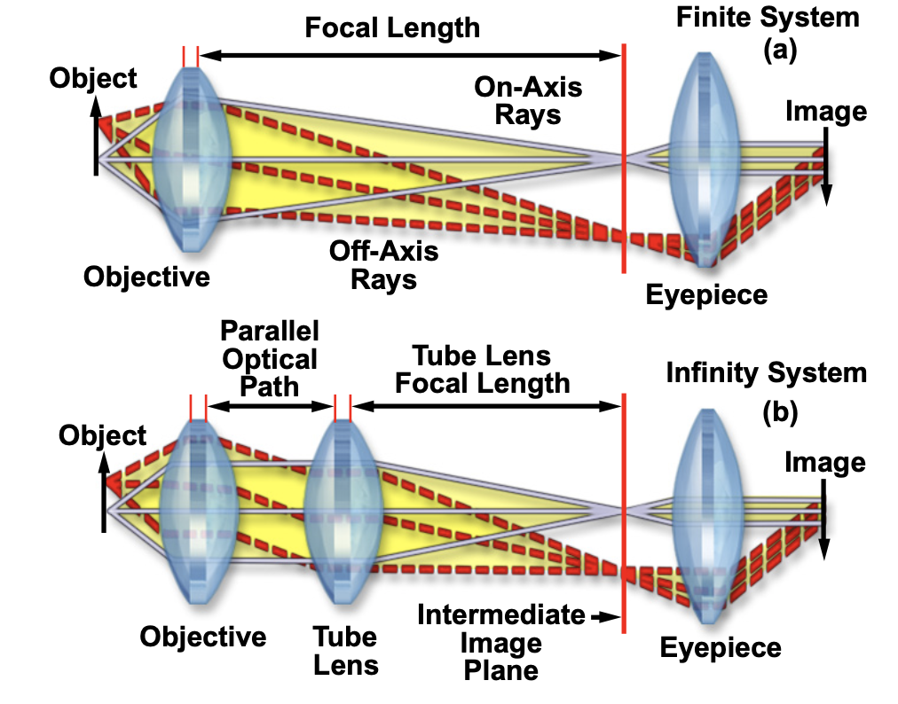
Infinity microscopes
Infinity microscopes have an additional lens (Tube lens)
The object is placed in the focal point of the objective lens, so that the rays after the objective lens are parallel.
The tube lens focusses the rays to form the intermediate Image₁
The distance between the objective lens and the tube lens is called the infinity space. This space can be varied without changing the magnification of the microscope.
This space can be used to introduce beam splitters, filters, dichroic mirrors, etc.

Slide 11
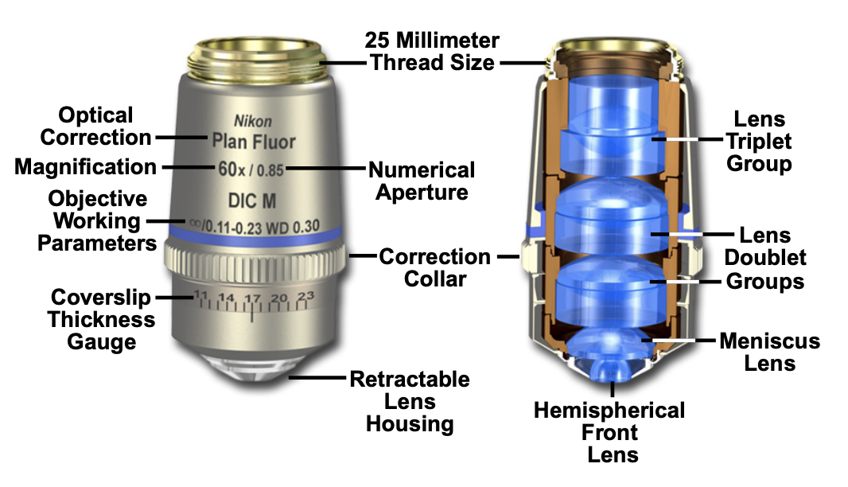
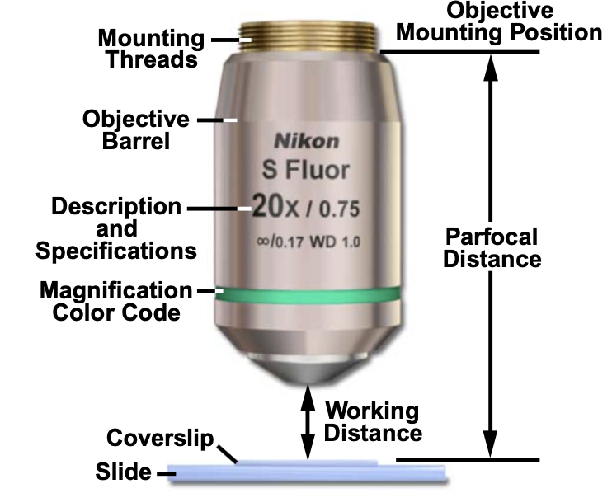
Microscope objectives
The quality of the objective is paramount for the image quality. Objectives can be very complex and can cost 10s of thousands of CHF!
They consist of a combination of many different lenses to correct for lens errors such as spherical or chromatic aberration.
Some important parameters for objectives are:
Magnification
Numerical aperture
Working distance
Oil/air/water immersion
Parfocal length
Thread size

Slide 12
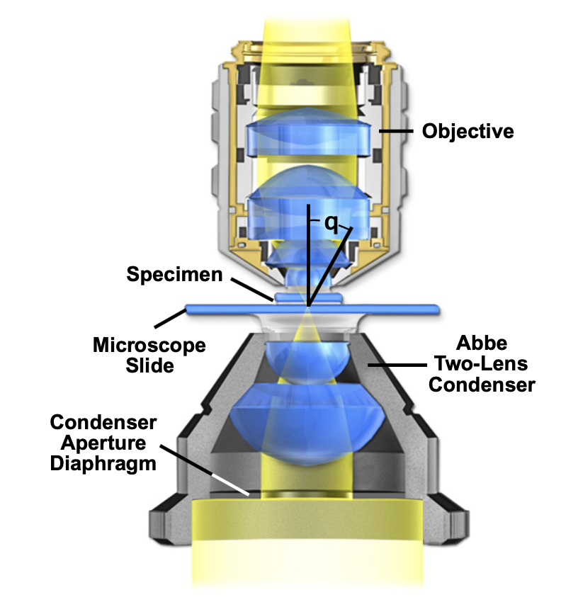
Illumination system
Unless an object emits light on its own, we need to illuminate it to see it.
Illumination can be grouped in different categories
Through illumination (for microscopy techniques that measure how ”transparent” samples interact with light)
Top illumination (for microscopy techniques that measure how ”reflective” samples interact with light)
For illumination it is important that we Illuminate the sample with enough light and that the light is uniform.
The optical principles behind illumination are the same as those for the image formation system.

Slide 13
The preferred type of illumination is Köhler illumination:
Köhler illumination ensures uniform illumination and can be used to regulate the amount of light that illuminates the sample using apertures.
An image of the lamp is projected using the collector lens onto the front focal plane of the condenser. The condenser transforms this image into a parallel ray of light illuminating the sample.

Slide 14
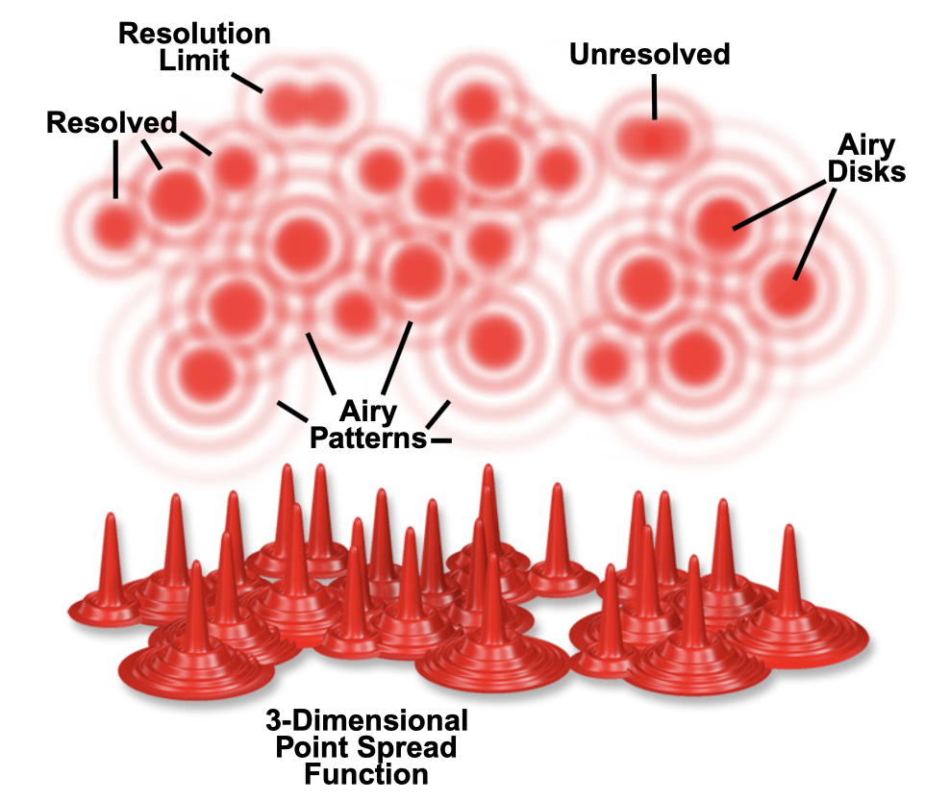
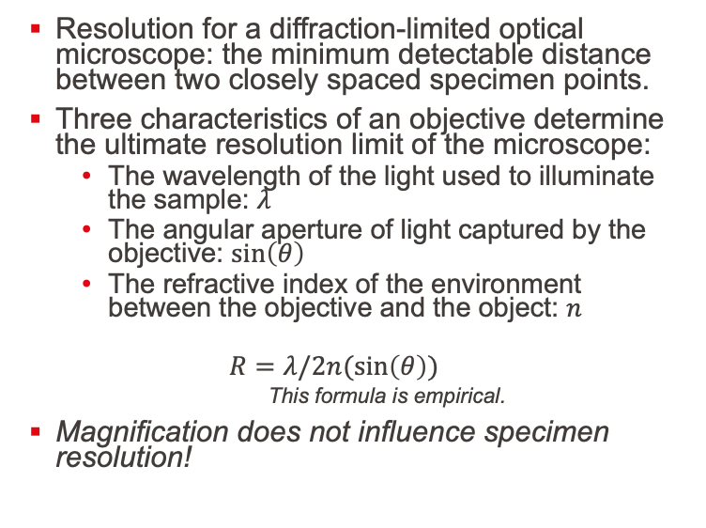
Resolution
Resolution for a diffraction-limited optical microscope: the minimum detectable distance between two closely spaced specimen points.
Three characteristics of an objective determine the ultimate resolution limit of the microscope:
The wavelength of the light used to illuminate the sample: $λ$
The angular aperture of light captured by the objective: $\sin\left(θ\right)$
The refractive index of the environment between the objective and the object: $n$
$$R=λ/2n(\sin\left(θ\right))$$
This formula is empirical.
Magnification does not influence specimen resolution!

Slide 15
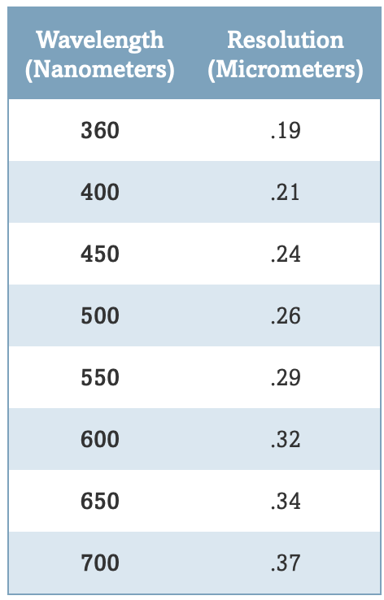
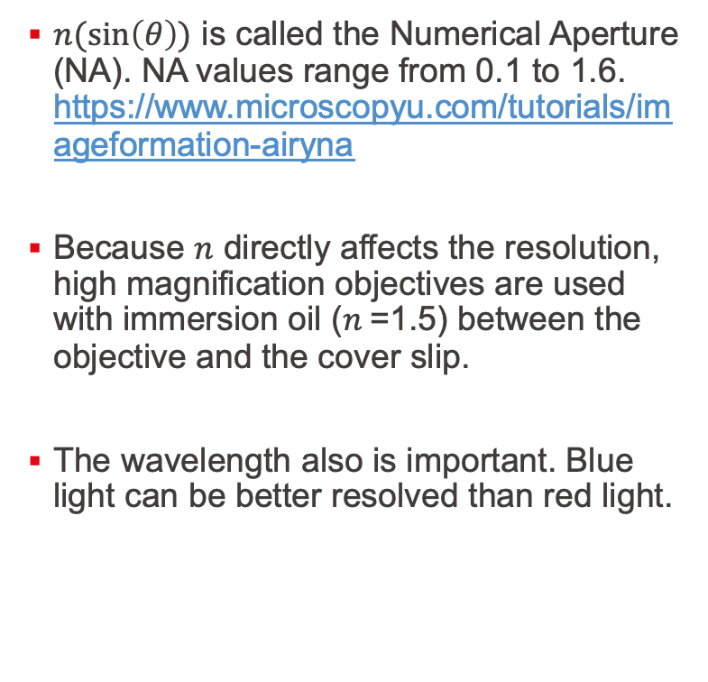
$n(\sin\left(θ\right))$ is called the Numerical Aperture (NA). NA values range from 0.1 to 1.6. https://www.microscopyu.com/tutorials/imageformation-airyna
Because $n$ directly affects the resolution, high magnification objectives are used with immersion oil ($n$=1.5) between the objective and the cover slip.
The wavelength also is important. Blue light can be better resolved than red light.

Slide 16
Different microscope setups
Upright microscope
Inverted microscope

Slide 17
Many different optical microscope modes exist
Bright-field
Dark field
Phase contrast
Differential interference contrast (DIC)
Fluorescence
…

Slide 18
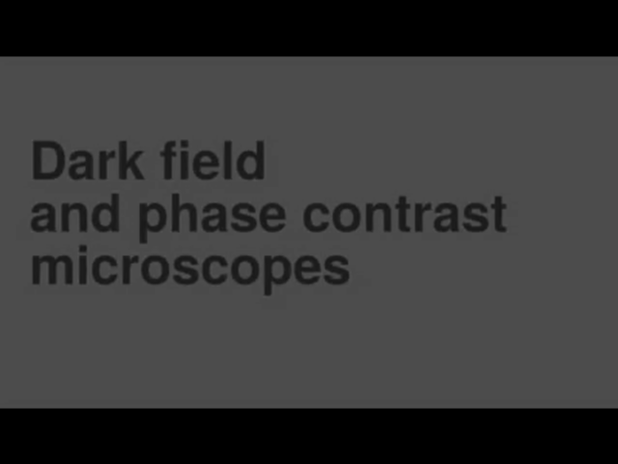
Darkfield and phase contrast

Slide 19
Brightfield
Dark field
Phase contrast

Slide 20
Fluorescence microscopy

Slide 21
Fluorescence microscopy
Jabnlonski diagram
In fluorescence micros copy we image the light emitted by the sample itself.
In order to make the sample emit light, it has to be excited with a wavelength having more energy.
When a photon is absorbed, molecules can be excited from the ground state to an excited state.
When the molecules relax from the excited state into the ground state they emit a photon.
The difference in wavelength between excitation and emission is called the Stokes shift.

Slide 22
The sample is excited by one wavelength (excitation wavelength)
The image is formed by collecting the emission wavelength
The excitation wavelength and the emission wavelength are separated by filter cubes. A filter cube exists of an excitation filter, a dichroic mirror and an emission filter

Slide 23
Fluorescent filters
You need the right filter set for each fluorophore
The dichroic mirror reflects the excitation wavelength but passes the emission wavelength, thereby separating the incoming and outgoing light.
Some filter cubes exist for dual colour viewing

Slide 24
Samples can either be naturally fluorescent or can be labelled.
Naturally occurring fluorescence happens in minerals, coral, animals,…

Slide 25
To make non fluorescent specimens fluorescent, they can be labelled with fluorescent molecules (fluorophores).
Some molecules are fluorescent due to their electron-structure. Examples are fluorescine, rhodamine, DAPI,…
Some proteins are fluorescent: green fluorescent protein (GFP), ref fluorescent protein (RFP), etc. These proteins can be cloned into organisms to make specific proteins in cells light up in the microscope. This is widely used in biology.

